Slide 1


Slide 2

Welcome to a multi-threaded web!
deadlocks may or may not be part of your experience…

Slide 3


Who am I?
Front-end Technical Leader
Programming enthusiast
Software designer

Slide 4
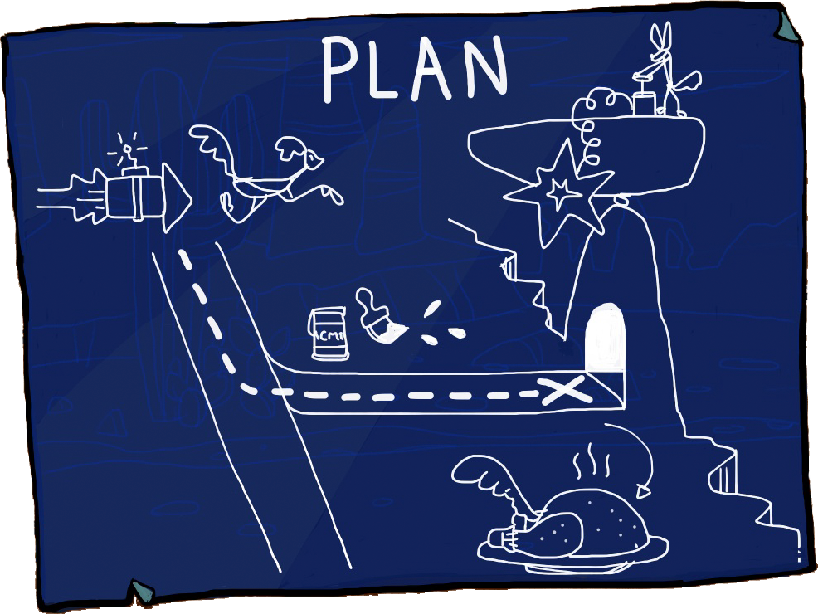
The plan!
Presentation
Q&A
Demos
Q&A

Slide 5


Slide 6
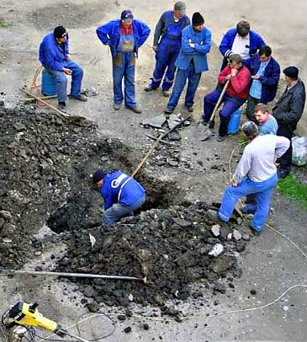
Web Browsers…
What is a web browser
Retrieve Resources
Display Data
An OS?
Single Thread

Slide 7

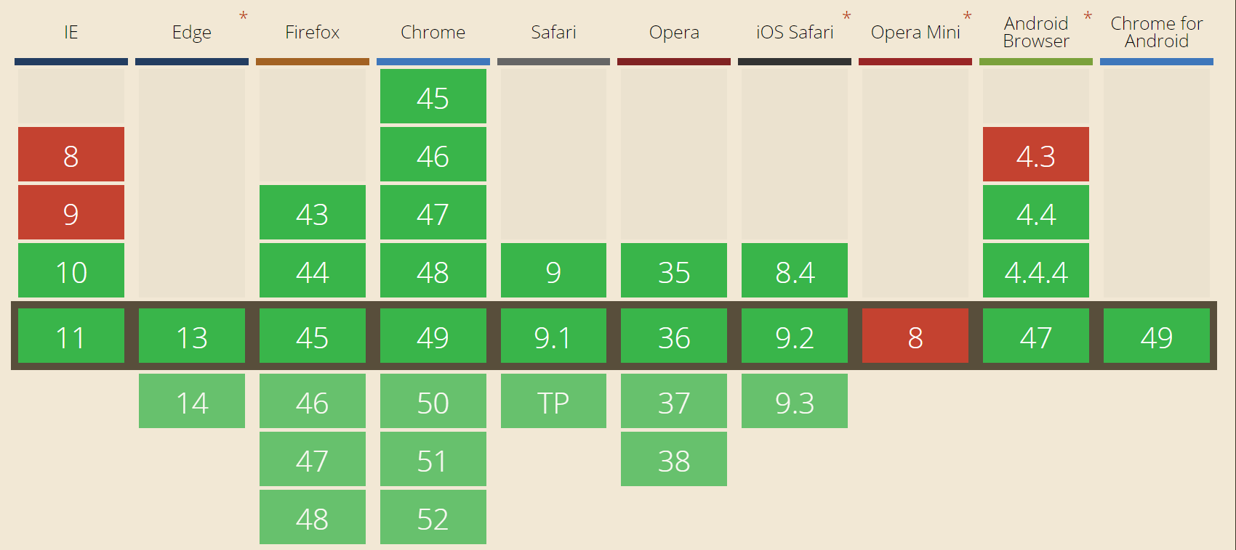
Browser support

Slide 8



Types of Workers!
Service
Shared
Dedicated

Slide 9
What is a Web Worker?
Web Page
(Window)
Web Worker
(Worker Global Scope)
RegEx
Math
Date
XHR
XHR
Document
Array
Location
Location
Element
Attributes
File Reader
Navigator
Navigator
Worker
Import Script
Web Socket
atob & btoa
…

Slide 10
What is it good for?
Prefetching and/or caching data
Intensive strings operations
Analysing video or audio data
Background I/O or polling of web services
Handle large arrays or JSON responses
Image manipulations
Updating local web database
WebGL

Slide 11
Worker’s live cycle – C^4
Creation
Communication
Calculation
Communication
Closing

Slide 12
Worker events
Error
LanguageChange
Offline
Online
RejectionHandled
UnhandledRejection
Connect
Message

Slide 13
Event Model
Main Script
Worker
Listening for message event
Listening for message event
Processing message
Processing message
MESSAGE EVENT
MESSAGE EVENT
Send message to worker
Send message to Main Script

Slide 14
Worker creation
Worker constructor
Worker URL
Options
new Worker('w/main-worker.js', {options});

Slide 15

Worker creation
// MAIN SCRIPT
var w = new Worker('w/main-worker.js', {type: 'classic'});
// WORKER
importScripts('sub-worker.js');

Slide 16
Communication
Post Message
w.postMessage({prop: val});
onmessage = function(event) {
// do stuff with “e”
// e.data => {prop: val}
};

Slide 17
Communication
Transferable Objects
w.postMessage({prop: buffer}, [buffer]);
onmessage = function(event) {
// do stuff with “e”
// e.data => {prop: buffer}
};

Slide 18
Event Model
Main Script
Worker
Listening for message event
Listening for message event
Processing message
Processing message
MESSAGE EVENT
MESSAGE EVENT
Send message to worker
Send message to Main Script

Slide 19
// MAIN SCRIPT
w.postMessage({object});
// WORKER
onmessage = function(e) {
// Do stuff
};
postMessage({object});
// MAIN SCRIPT
w.onmessage = function(e) {
// Do stuff
};

Slide 20
Spawning workers
Main Script
Worker

Slide 21
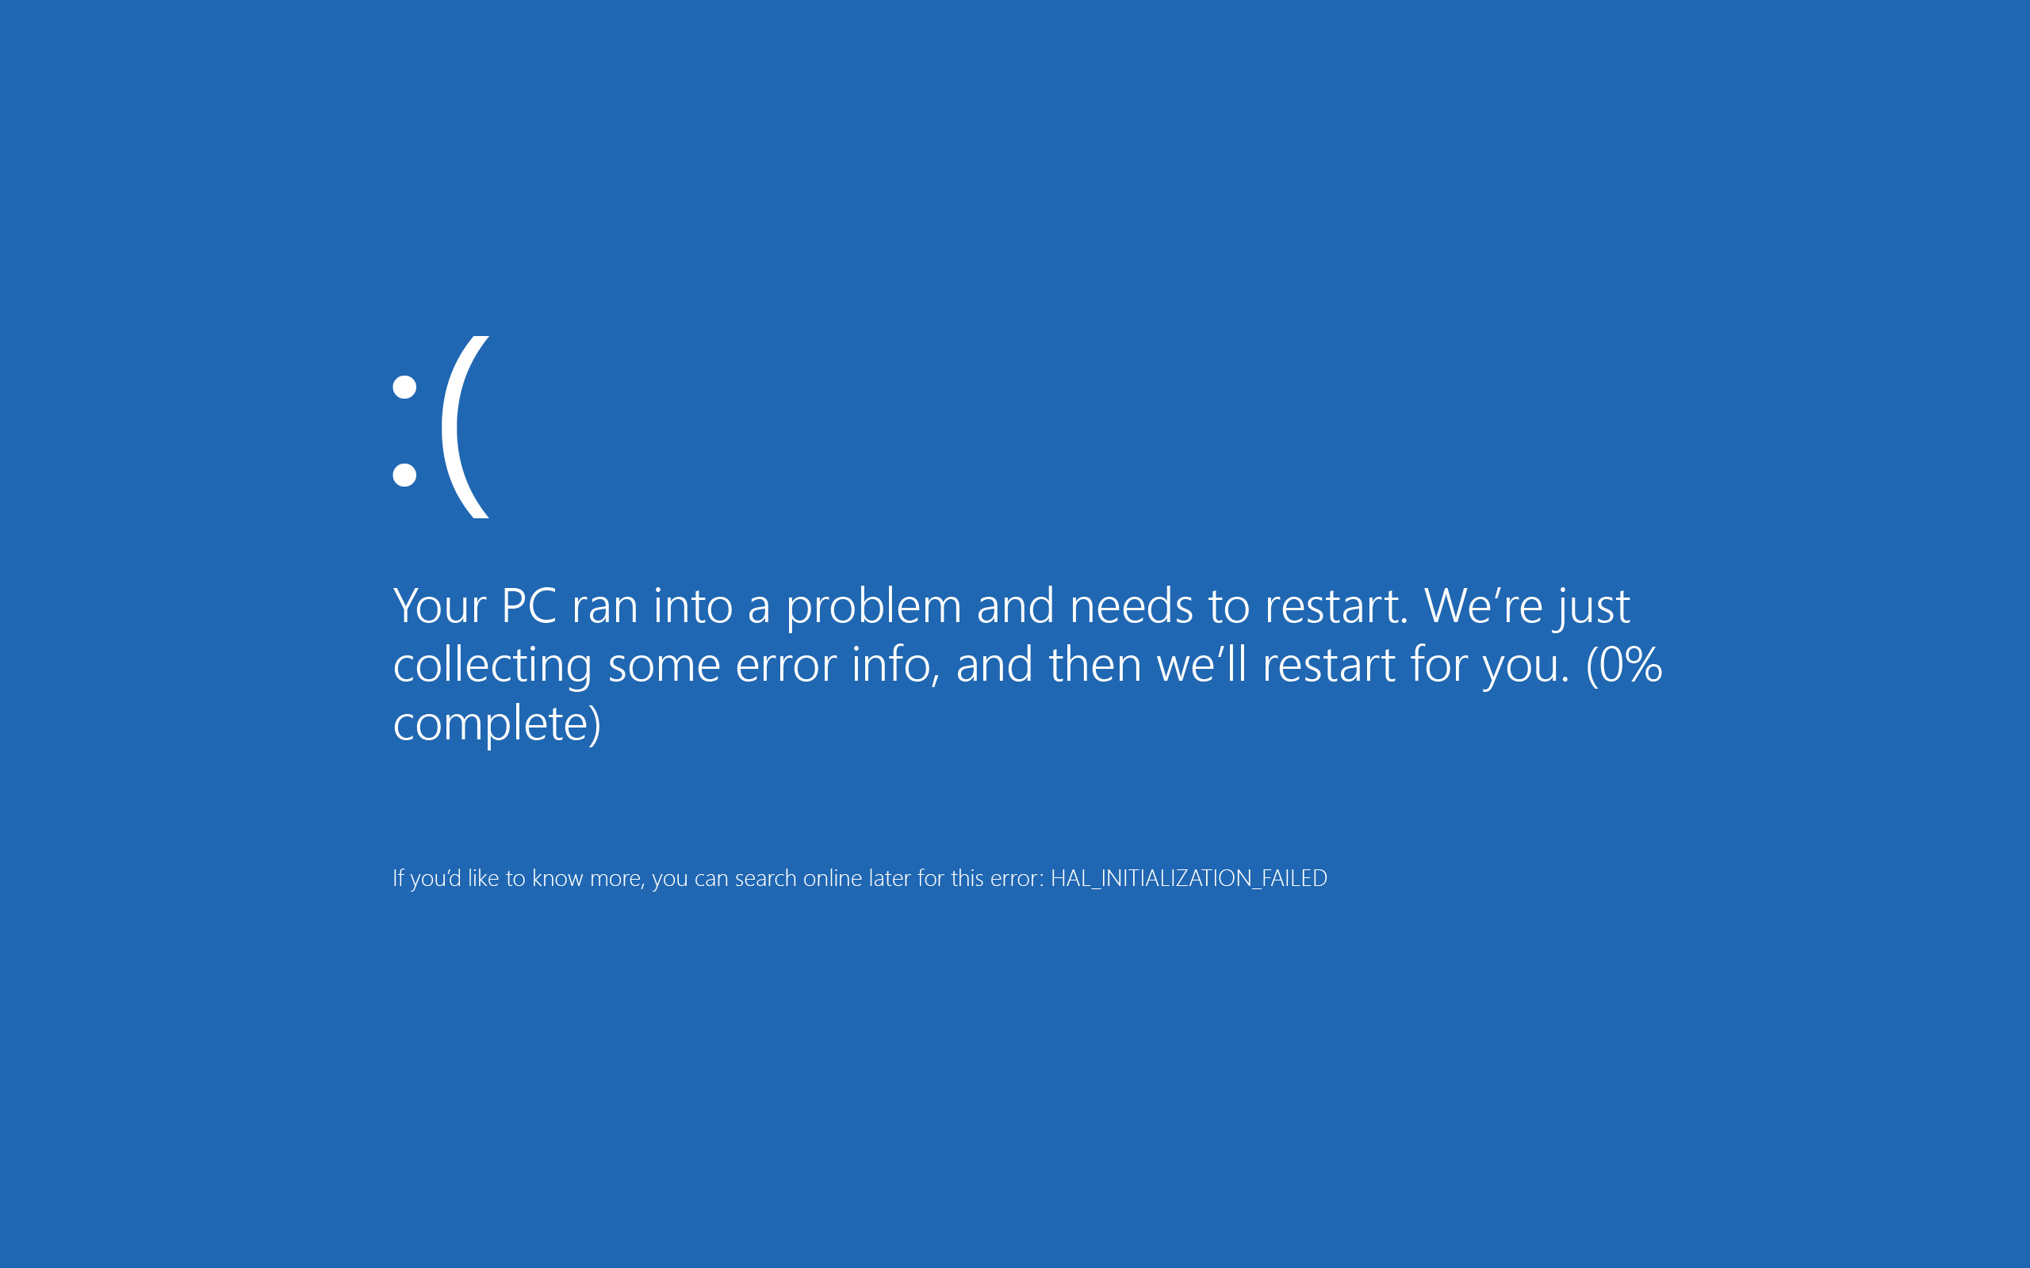

Slide 22
Limitations
Software
Hardware

Slide 23


Slide 24
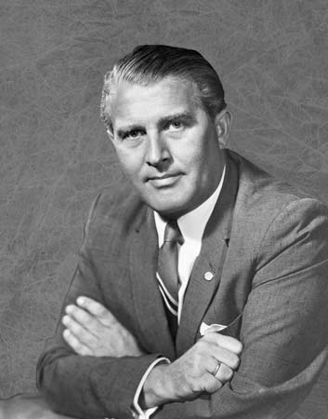
“One good test is worth a thousand expert opinions.” ― Wernher von Braun

Slide 25
DEMOS!
Basic setup
Heavy calculations
Sub worker
API implementation
Multi-threaded
Transferrable objects

Slide 26


Slide 28


Slide 29
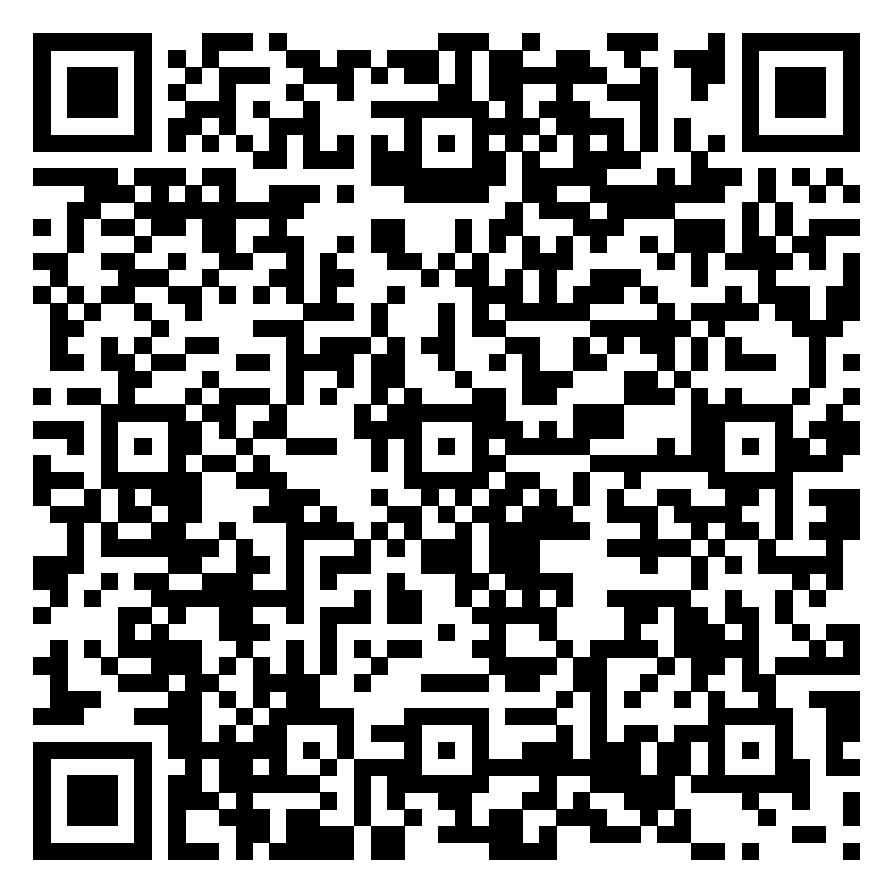
Links
Connect:
LinkedIn: https://goo.gl/CRRJ2Y
Mail: martin.c@sbtech.com
Github: https://github.com/mchaov
Web Workers :
https://html.spec.whatwg.org/multipage/workers.html
https://developer.mozilla.org/en-US/docs/Web/API/Web_Workers_API
https://goo.gl/oZl2b6

